Slide 1
3. Strength vs concentration
GE002

Slide 2
You need to be able to….
Outline the difference between a strong acid and a weak acid.
Define concentration and how it can affect reaction rate.

Slide 3
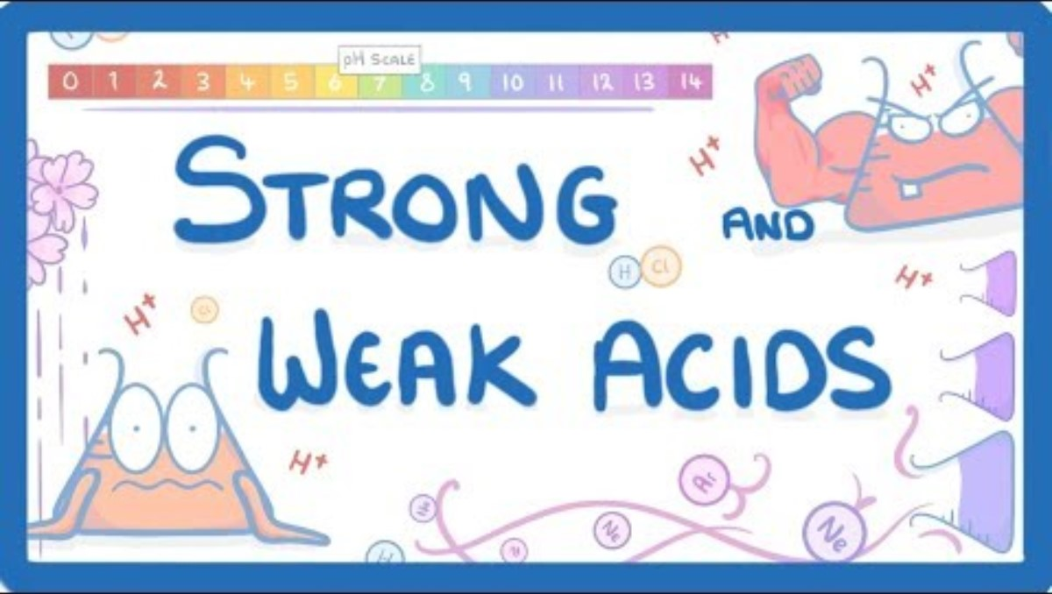

Slide 4
Strong vs weak acids
Strong – all of the acid particles dissociate completely into ions.
HCl HNO₃ H₂SO₄
Weak – only some of the acid particles dissociate into ions. Also, the reaction reverses, resulting in an equilibrium of un-disassociated and disassociated ions.
CH₃COOH C₆H₈O₇ H₂CO₃

Slide 5
Concentration
How much acid or base there is in a certain volume.

Slide 6


Slide 7
What is a mole?
The unit measuring quantities of a chemical.
A mole of anything contains 6.02 x 10²³ individual particles of that chemical.

Slide 8


Slide 9
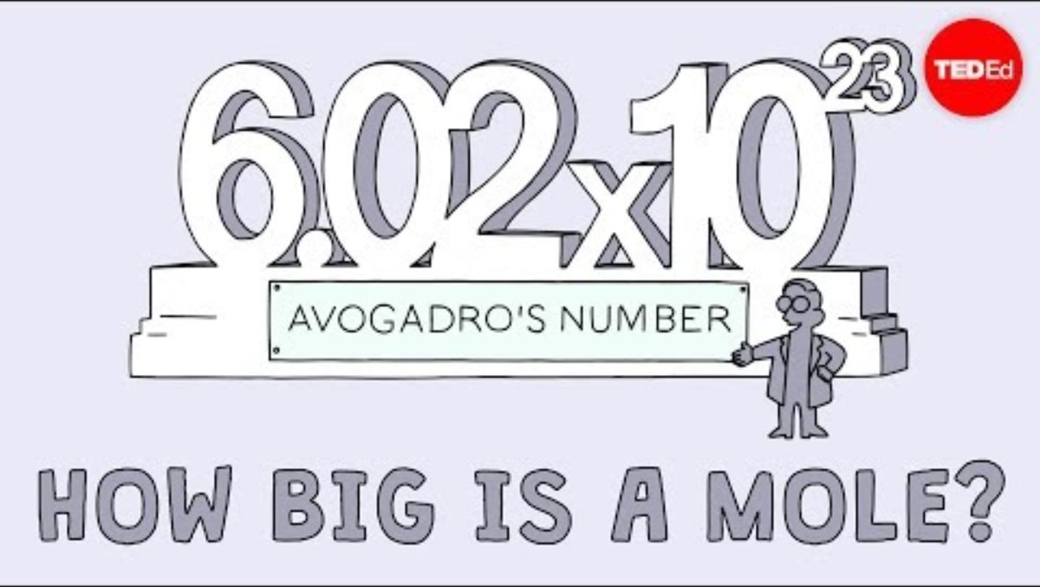

Slide 10
What does 0.1M concentration mean?
For every litre of solution, there are 0.1 moles of the dissolved substance.
M = Molarity = mol per Litre of solution

Slide 11
ClickView: The pH Scale

Slide 12
Are you now able to….
Outline the difference between a strong acid and a weak acid.
Define concentration and how it can affect reaction rate.

